Slide 1
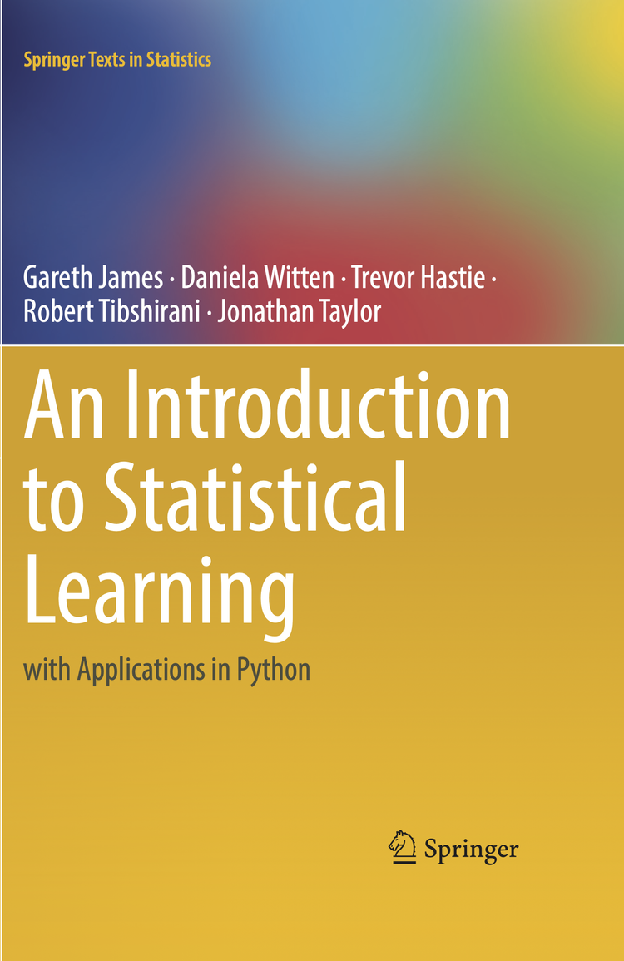
Exercises ISLR – Ch.3
Marcelo Previato Simoes Nº 2367070
25/08/2025

Slide 2

Conceptual
Exercises: 5, 6

Slide 3
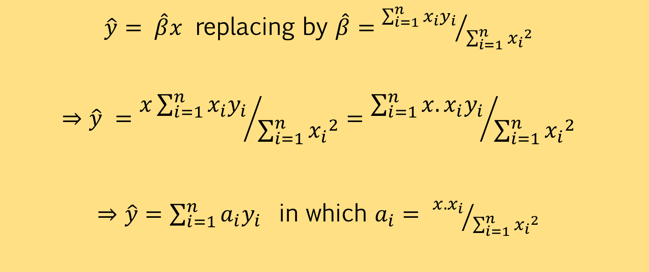
Exercise 5) Regression without intercept
$\hat{y}=$ $\hat{β}x$ replacing by $\hat{β}={\sum_{i=1}^{n}{x_{i}y_{i}}}/{\sum_{i=1}^{n}{{x_{i}}^{2}}}$
$$⇒\hat{y} ={x\sum_{i=1}^{n}{x_{i}y_{i}}}/{\sum_{i=1}^{n}{{x_{i}}^{2}}}={\sum_{i=1}^{n}{{x.x}_{i}y_{i}}}/{\sum_{i=1}^{n}{{x_{i}}^{2}}}$$
$⇒\hat{y}=\sum_{i=1}^{n}{a_{i}y_{i} }$ in which $a_{i}=$ ${x.x_{i}}/{\sum_{i=1}^{n}{{x_{i}}^{2}}}$

Slide 4
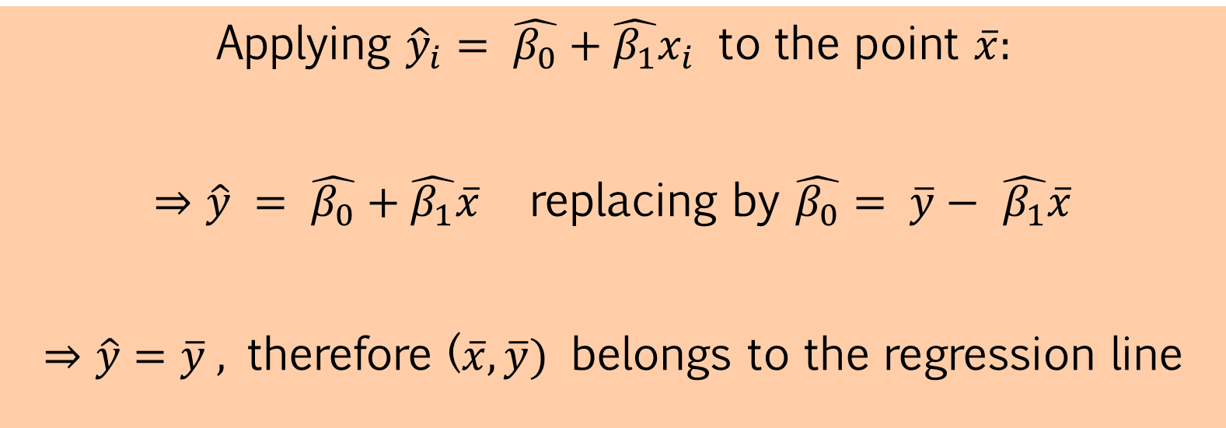
Exercise 6) Regression line through the means
Applying ${\hat{y}}_{i}=$ $\hat{β_{0}}+\hat{β_{1}}x_{i}$ to the point $\overline{x}:$
$⇒\hat{y} =$ $\hat{β_{0}}+\hat{β_{1}}\overline{x}$replacing by $\hat{β_{0}}= \overline{y}−$ $\hat{β_{1}}\overline{x}$
$⇒\hat{y}=\overline{y} ,$ therefore ($\overline{x},\overline{y})$ belongs to the regression line

Slide 5

Applied
Exercise 15

Slide 6

Exercise 15a) Simple Regression (Boston)
Dependent Variable: crim (per capita crime rate per town)
All variables with coefficients statistically significant at 95%, except for Charles River proximity (chas)
Coefficient SIGNIFICANT (95%) | Coefficient NOT significant
zn | chas
Ind
nox
rm
age
dis
rad
tax
ptratio
black
lstat
medv

Slide 7
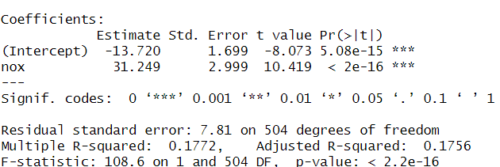
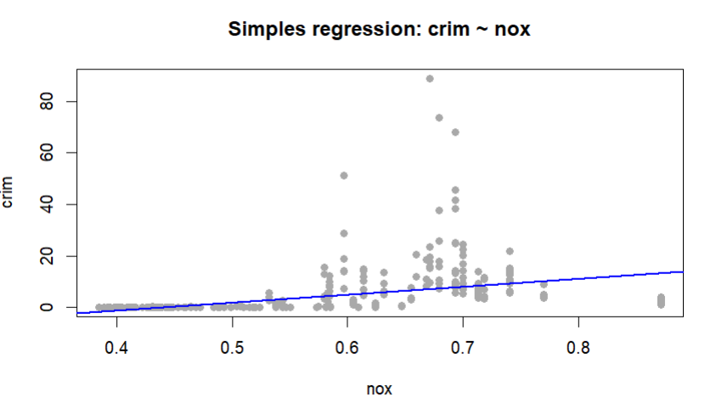
Exercise 15a) Simple Regression (Boston)
Example: variable Nox
Significant, but it explains only 17.72% of the variance

Slide 8
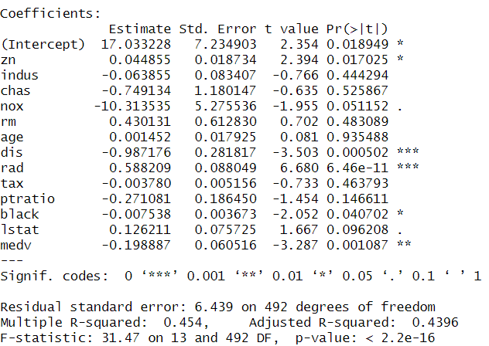
Exercise 15b) Multiple Regression
Dependent Variable: crim (per capita crime rate per town)
Only 5 variables remain significant: zn, dis, rad, black, medv

Slide 9
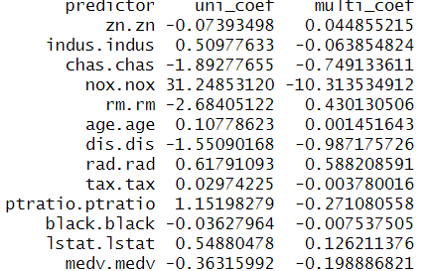
Exercise 15c) Coefficients comparison
Relevant change in coefficients: 7 out of 13 variables changed had their coefficient sign changed

Slide 10
Exercise 15d) Non-linear association
Dependent Variable: crim + up to cubic association
Only 5 variables seem to have non-linear association
Non-linear Association Coefficient SIGNIFICANT (95%) | Non-linear Association Coefficient NOT significant
ind | chas
nox | zn
age | rm
dis | rad
medv | tax
 | ptratio
 | black
 | lstat

Slide 11
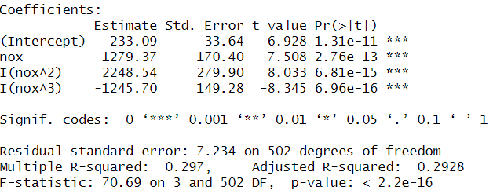
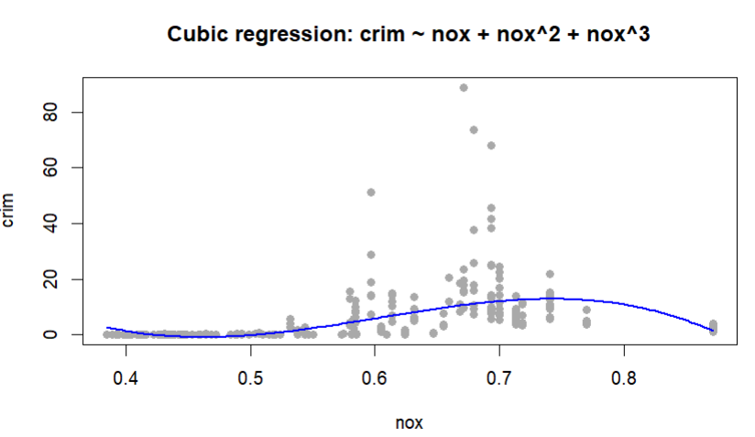
Exercise 15d) Non-linear association
Example: variable Nox up to cubic term
Significant, and now it explains 29.7% of the variance

